Slide 1
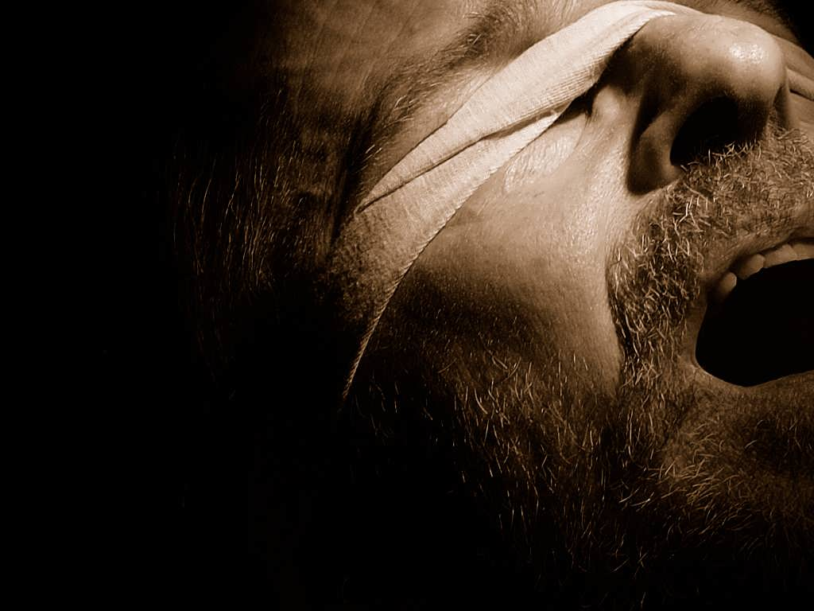


the bondage of
Cults and Isms
Wicca
A free CD of this message will be available following the service
It will also be available for podcast later this week at calvaryokc.com

Slide 2
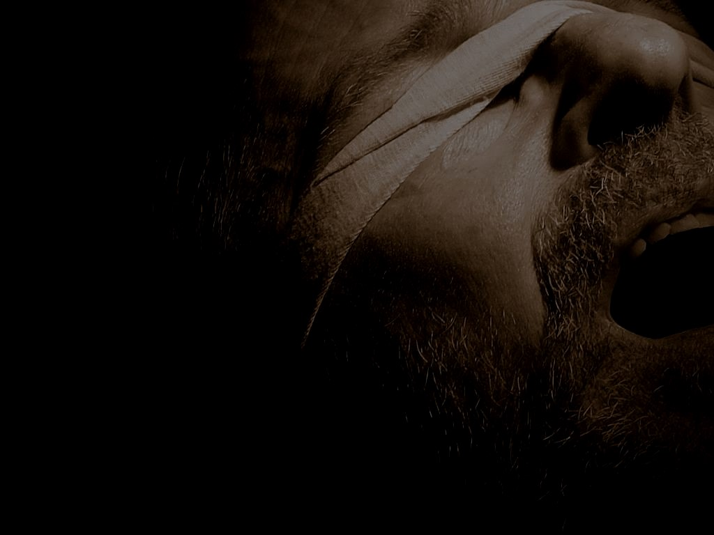

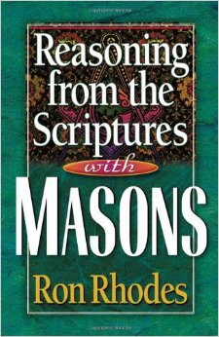
$15.50
$4.80
the bondage of Wicca

Slide 3
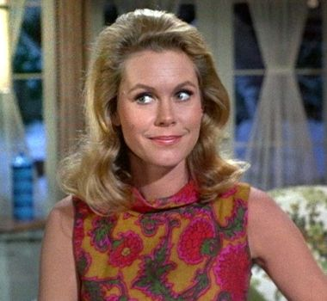
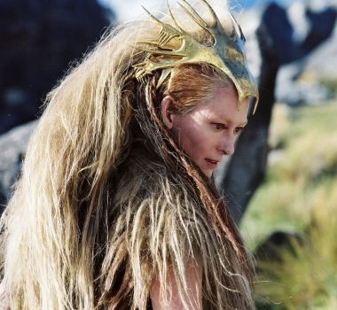
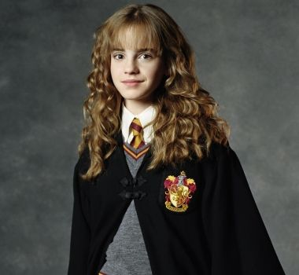

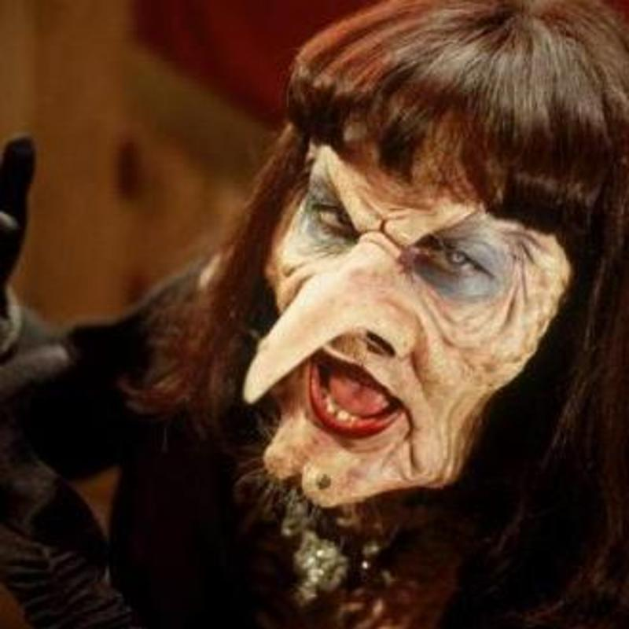
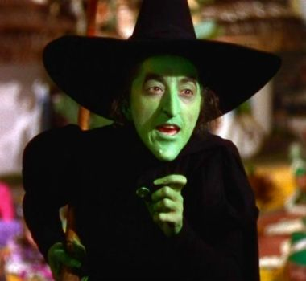
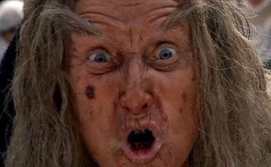
the bondage of Wicca

Slide 4
the bondage of Wicca

Slide 5
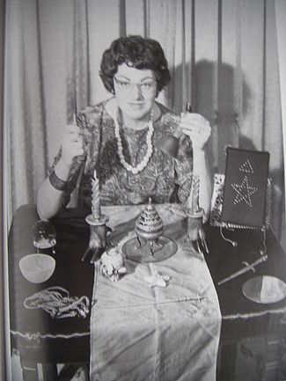
The Wiccan Rede ~ “An it harm none, do what ye will.”
“If it harms no one, do what you want.”
“The Mother of modern witchcraft”
Doreen Valiente
(1922-1999)
the bondage of Wicca

Slide 6
Wizard
Warlock
Wiccan
Witch
Enchanter
Sorcerer
Enchantress
Sorceress
the bondage of Wicca

Slide 7
the bondage of Wicca

Slide 8
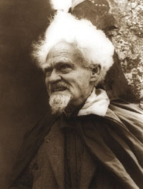
The “Father of Wicca”
Influenced by Rosicrucianism and Aleister Crowley
Gerald Gardner
1884-1964
the bondage of Wicca

Slide 9
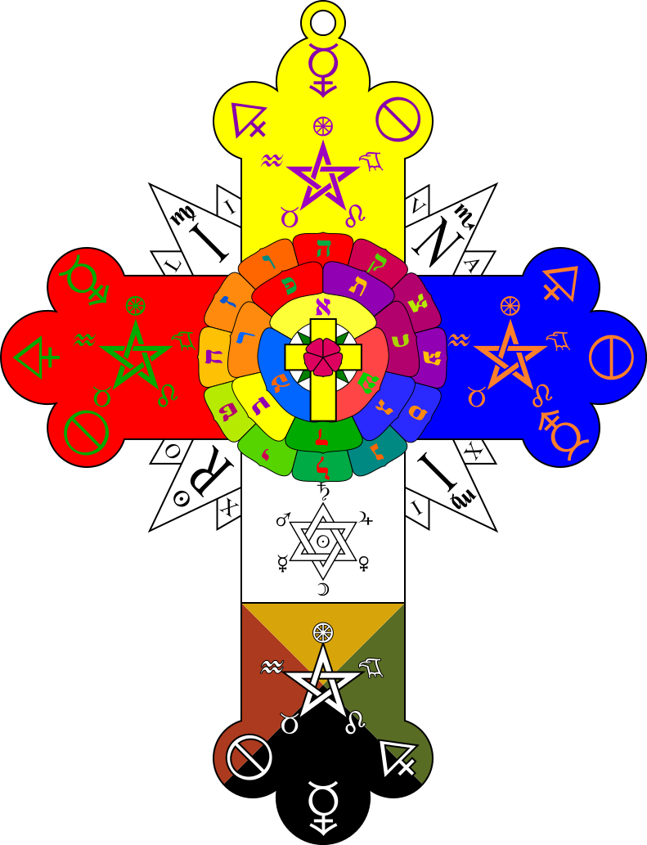
Beginnings in early 17th century
Influenced by Sufism (a form of existential Islam) and/or Zoroastrianism
The “Rosy Cross”
the bondage of Wicca

Slide 10
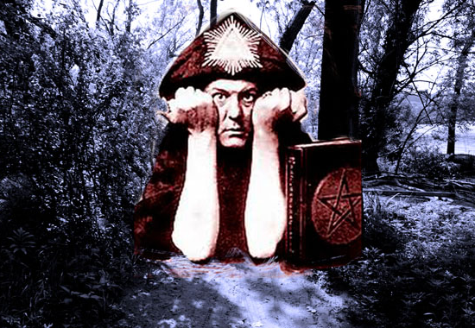

British press: “The most wicked man in the world.”
Aleister Crowley
(1875-1947)
Boleskine House
the bondage of Wicca

Slide 11
the bondage of Wicca

Slide 12
Satanist Lex Talionis (Law of Reprisal) ~ “Do unto others as they do unto you.”
Retaliation is their identifier
Wicca Rede ~ “An it harm none, do what ye will.”
“If it itches, scratch it”
the bondage of Wicca

Slide 13

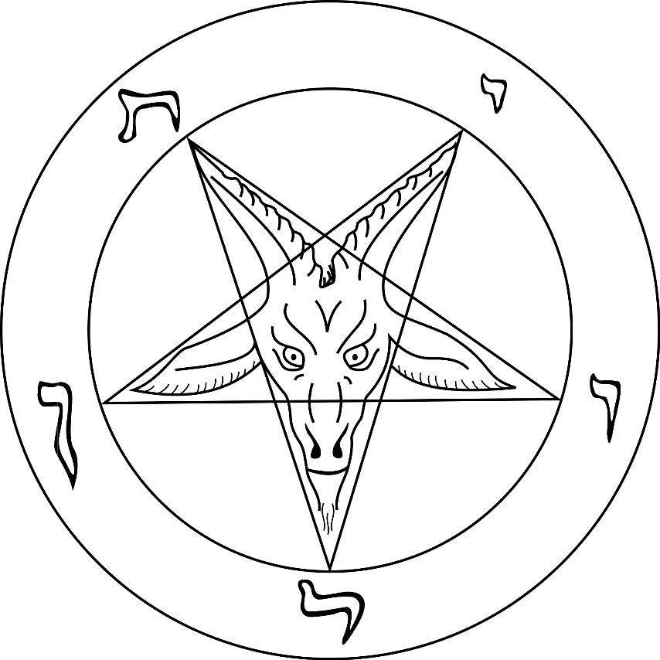
Sigil of Baphomet
Wiccan Pentacle
the bondage of Wicca

Slide 14

Wicca
Gerald Gardner
Aleister Crowley
Rosicrucianism
Sufi Islam
Zoroastrianism
the bondage of Wicca

Slide 15
Wicca Growth Chart
350,000
300,000
134,000
250,000
342,000
200,000
8,000
150,000
100,000
50,000
1990
1992
1994
1996
1998
2000
2002
2004
2006
2008
the bondage of Wicca

Slide 16
the bondage of Wicca

Slide 17
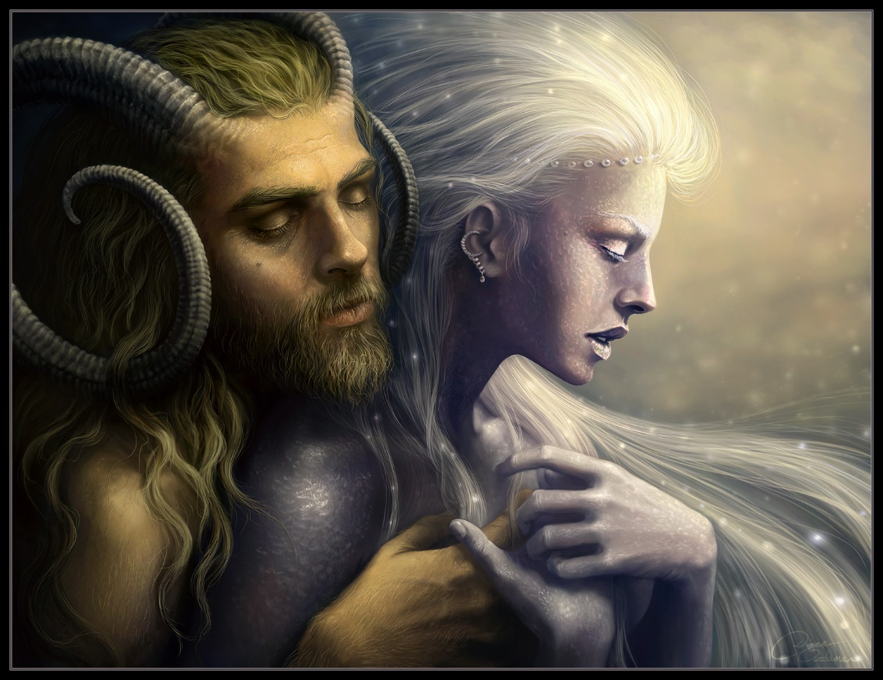

Horned god
Mother goddess
Yin/Yang
the bondage of Wicca

Slide 18
the bondage of Wicca

Slide 19
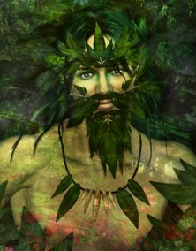
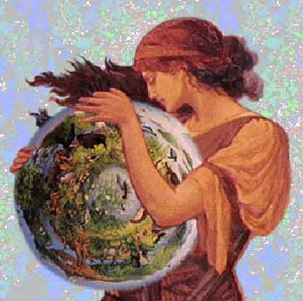
The Green Man
Mother of all life
the bondage of Wicca

Slide 20
the bondage of Wicca

Slide 21
Wiccans can run the gamut of believing in …
Pantheism (all is god)
Polytheism (there are many gods)
Monotheism (there is one god)
the bondage of Wicca

Slide 22
the bondage of Wicca

Slide 23
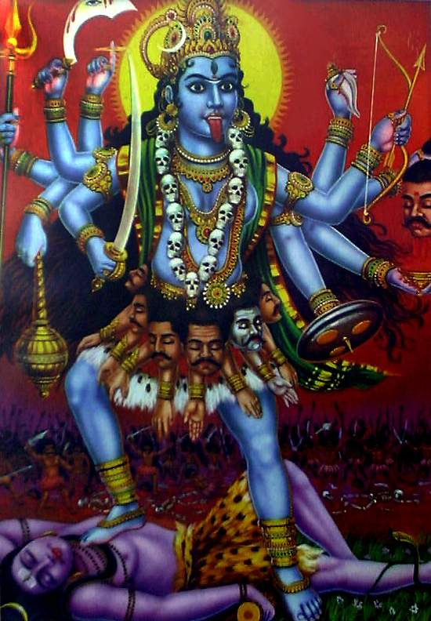
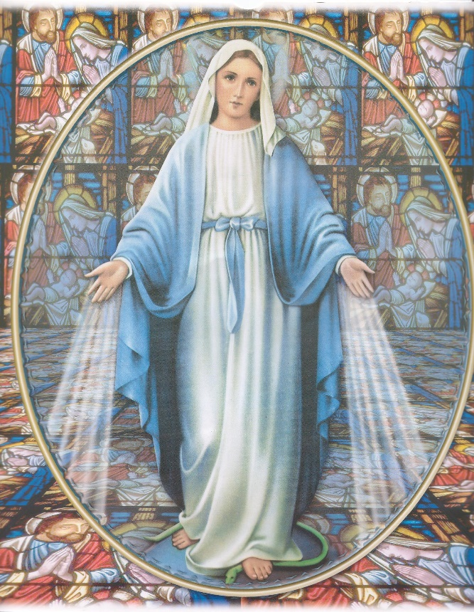
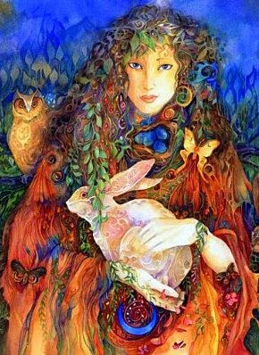
Virgin Mary
Eostre
Kali
the bondage of Wicca

Slide 24
the bondage of Wicca

Slide 25


Reincarnation
Transmigration of Souls
the bondage of Wicca

Slide 26
the bondage of Wicca

Slide 27
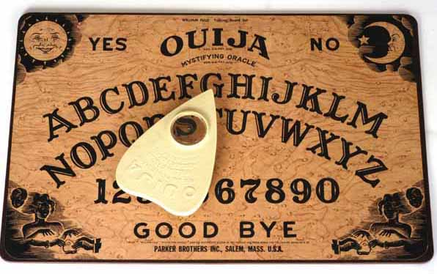
the bondage of Wicca

Slide 28
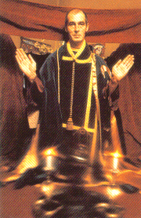
Sabbats ~ 8 seasonal festivals on the Wiccan calendar
Sabbat of Samhain (SAH-win)
October 31
High priest Alex Sanders (1926-1988) ~ “They are dead … leave them in peace”
the bondage of Wicca

Slide 29
the bondage of Wicca

Slide 30
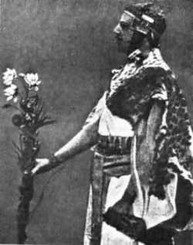
Magic, or Magick
Aleister Crowley ~ “The science and art of causing change to occur in conformity with will.”
“The science of the control of the secret forces of nature.”
MacGregor Mathers
1854-1918)
the bondage of Wicca

Slide 31
White magic vs. Black magic
White magic = good
Black magic = bad
the bondage of Wicca

Slide 32
Spirit
Water
Air
Earth
Fire
Wiccan Pentacle
the bondage of Wicca

Slide 33
the bondage of Wicca

Slide 34
Morality
Wiccan Rede ~ “An it harm none, do what ye will.”
Three-fold return ~ All actions, good or bad, will be returned with equal force on the body, soul and spirit
the bondage of Wicca

Slide 35
the bondage of Wicca

Slide 36
Is. 8.19-20 ~ ¹⁹ And when they say to you, “Seek those who are mediums and wizards, who whisper and mutter," should not a people seek their God? Should they seek the dead on behalf of the living? ²⁰ To the law and to the testimony! If they do not speak according to this word, it is because there is no light in them.
the bondage of Wicca

Slide 37
Gal 5.19-20 ~ ¹⁹ Now the works of the flesh are evident, which are: adultery, fornication, uncleanness, lewdness, ²⁰ idolatry, sorcery, hatred, contentions, jealousies, outbursts of wrath, selfish ambitions, dissensions, heresies,
the bondage of Wicca

Slide 38
the bondage of Wicca

Slide 39
Sheila (ex-Wiccan) ~ “After practicing magic for over 20 years, I never encountered any power like what I’ve encountered since I’ve been a Christian.”
the bondage of Wicca

